Slide 1
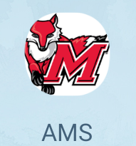
SECURITY ALGORITHM AND protocols
AMS
ATTENDANCE Management SYSTEM
PRABHLEEN KAUR
PROF : PABLO RIVAS
20089589

Slide 2

INTRO
AMS is an Android Application to track the attendance for each Individual student enrolled in different courses.
College credentials used to access the account
Display Student, course details and Schedule.
Unique Feature – Student Location is stored and displayed in Professors account .

Slide 3
System Specification
Hardware Requirements – Mobile ,Tablet or Ipad
Software Requirements – Android OS version 4.3 or above
Programming – JAVA , JSON
IDE – Android Studio version 3.1.2
Database – Firebase
Google Map APIs for Location tracking

Slide 4
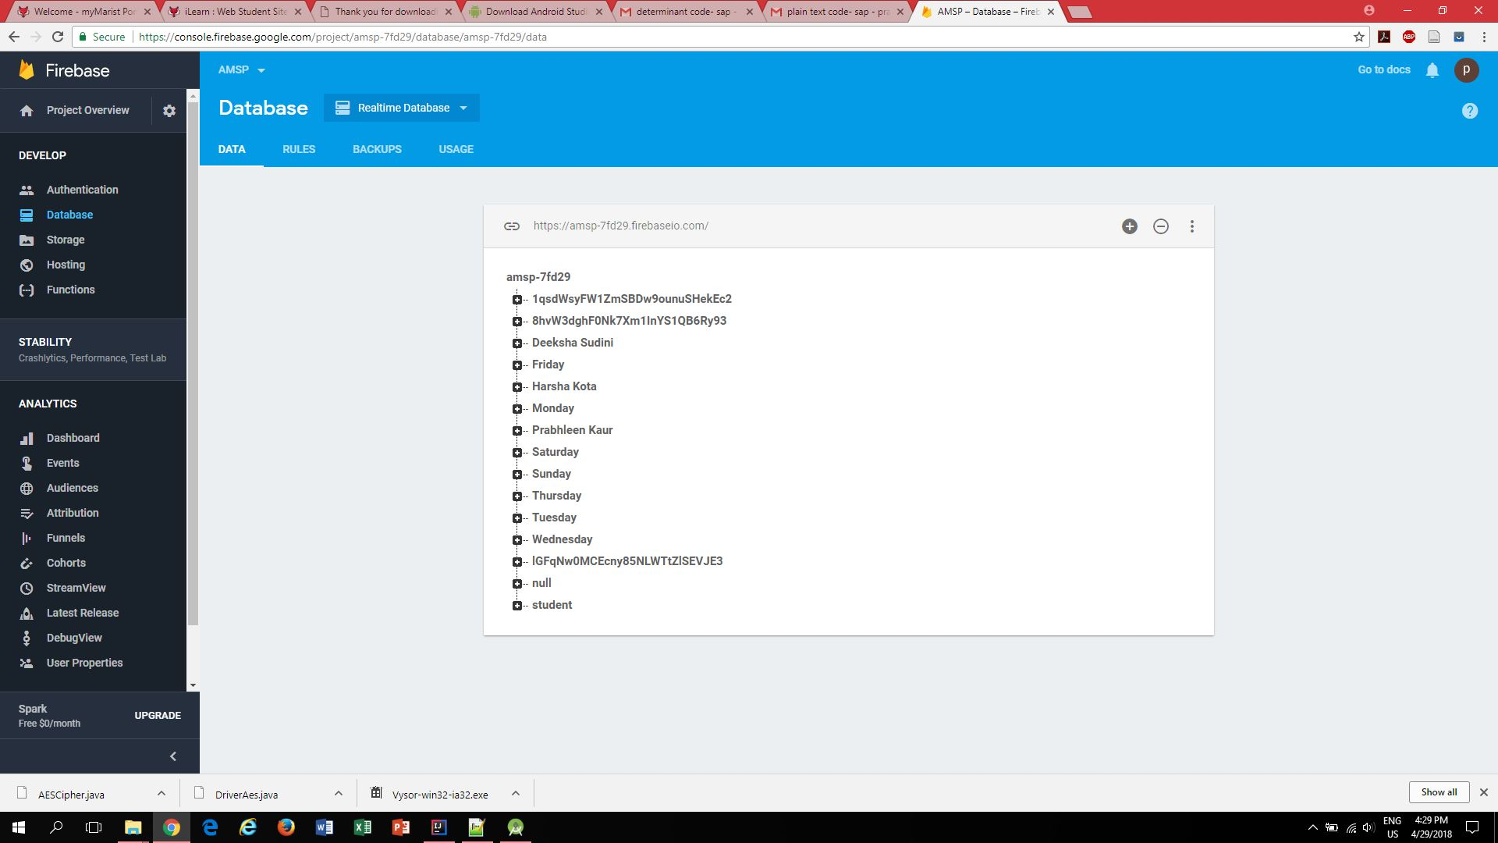
Firebase

Slide 5
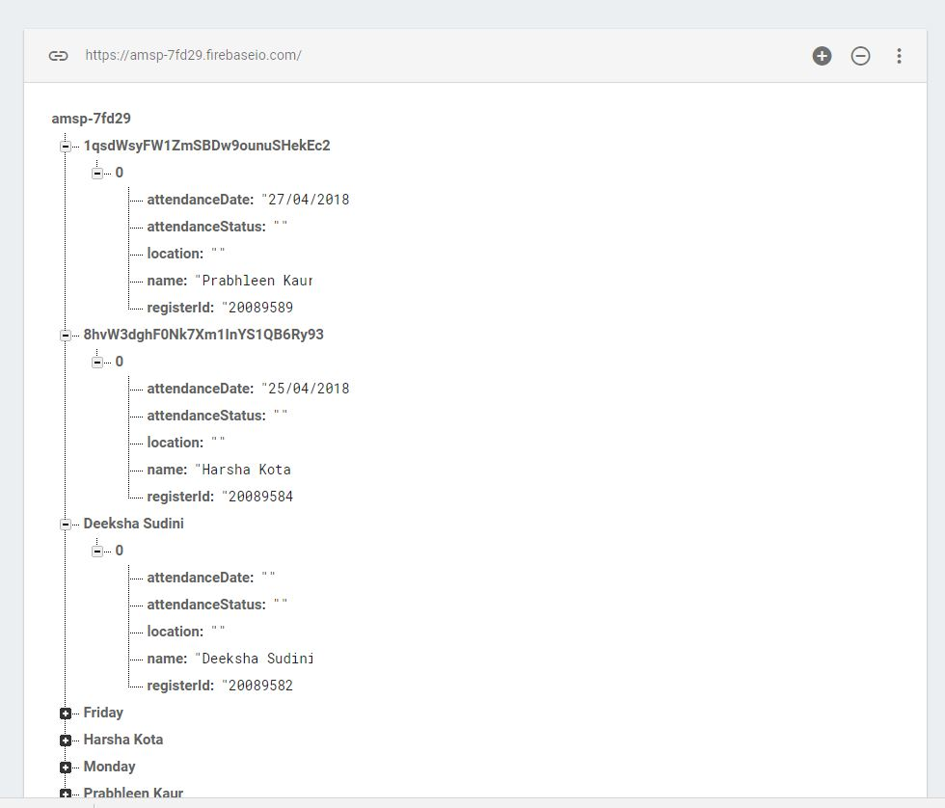
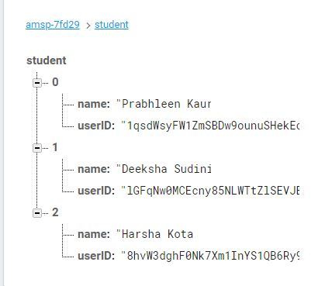
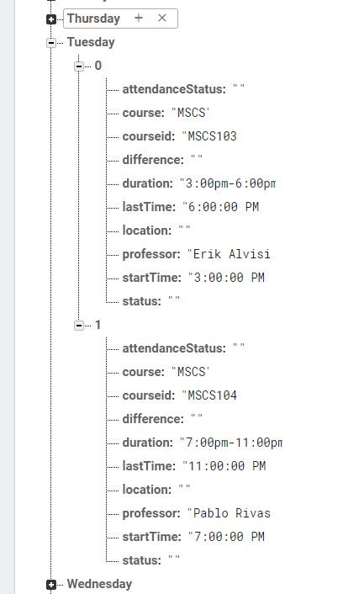

Slide 6
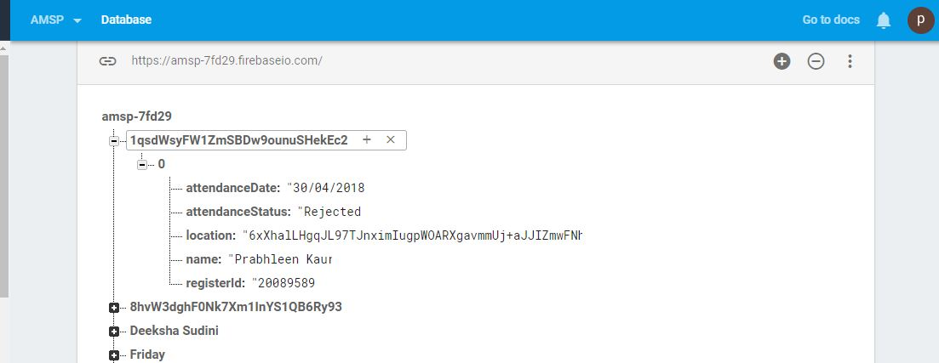
Encryption and decryption
AES (Advanced Encryption Standard) is implemented to encrypt current location of the student .
It uses 128 bit key , Base 64
It uses SHA-1

Slide 7
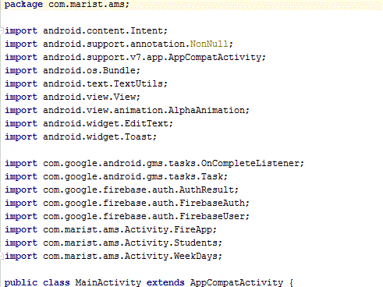
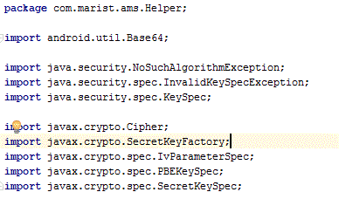
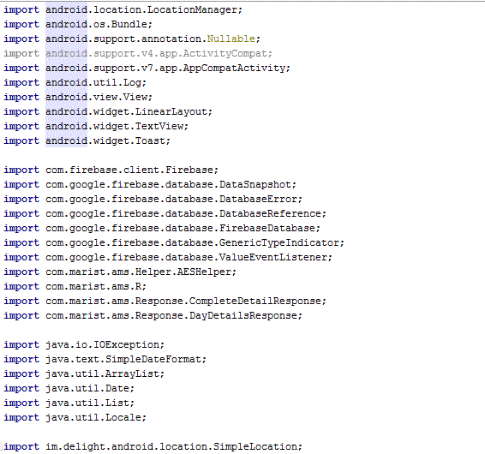
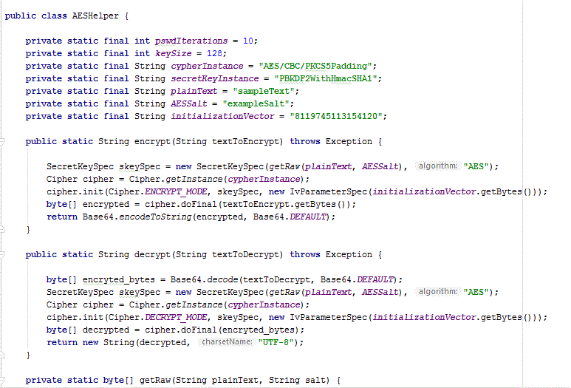

Slide 8
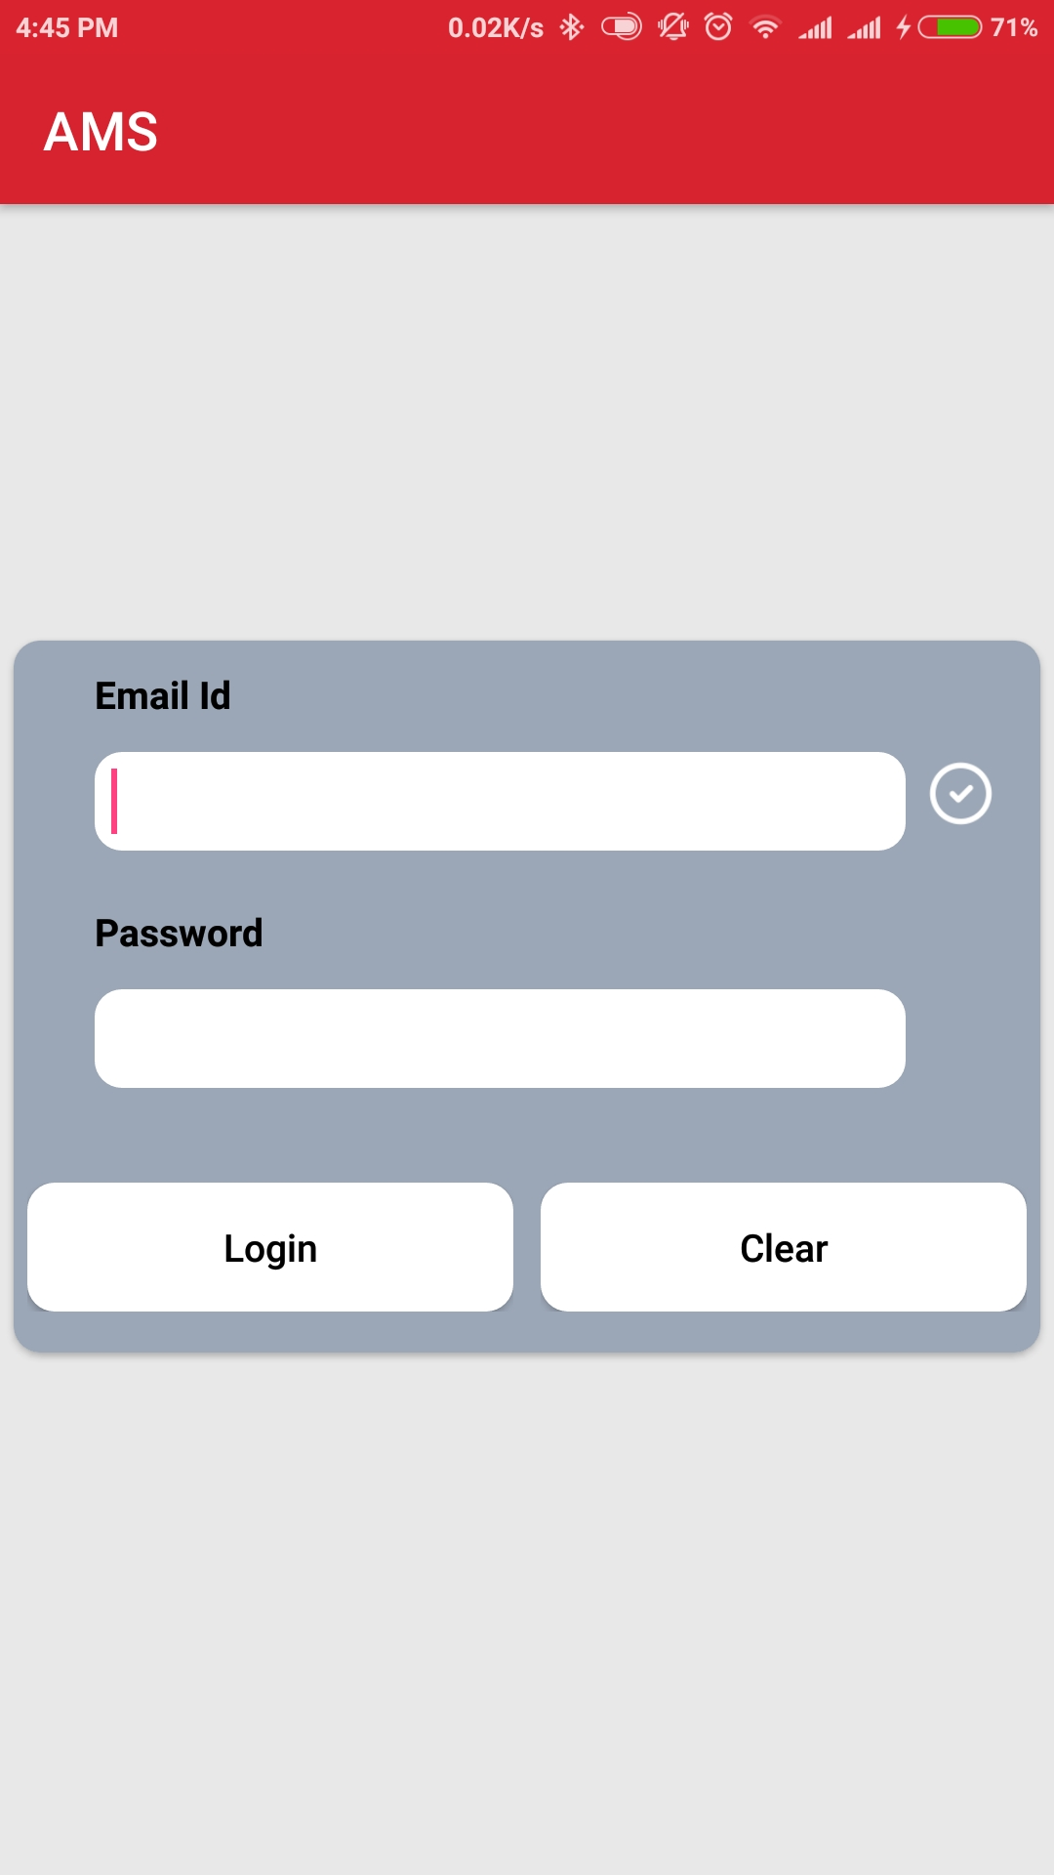
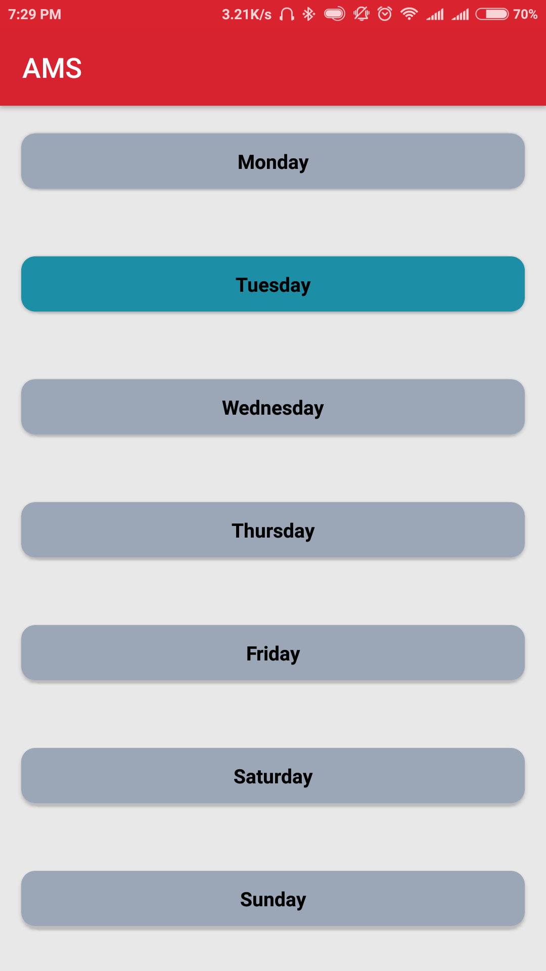
Student View

Slide 9
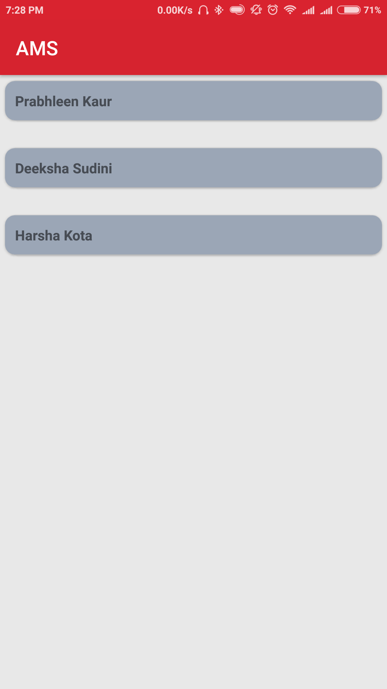
Professors View

Slide 10
Limitations
It shows Schedule only for current week
Student cannot retrieve the record for whole semester
Student has to manually turn On location permission
Can not be changed once Accepted or rejected
Future scope
Semester record available
Announcement and notification
Professor can view only students present in location same as professor
Extend on IOS platform

Slide 11

Demo

Slide 12
References
https://developer.android.com/studio/intro/index.html
https://firebase.google.com/docs/
https://developers.google.com/maps/documentation/
Vishal Bhalla, Tapodhan Singla, Ankit Gahlot, Vijay Gupta, "Bluetooth Based Attendance Management System", International Journal of Innovations in Engineering and Technology (IJIET).
https://www.youtube.com/watch?v=k1D0_wFlXgo

